Slide 1
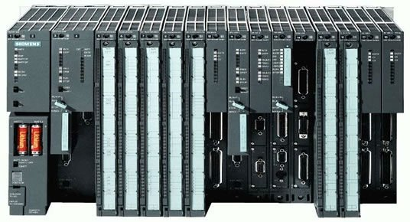
New ASYN Driver for S7 PLCs
Ralph Lange
ITER Organization
Control System Division

Slide 2
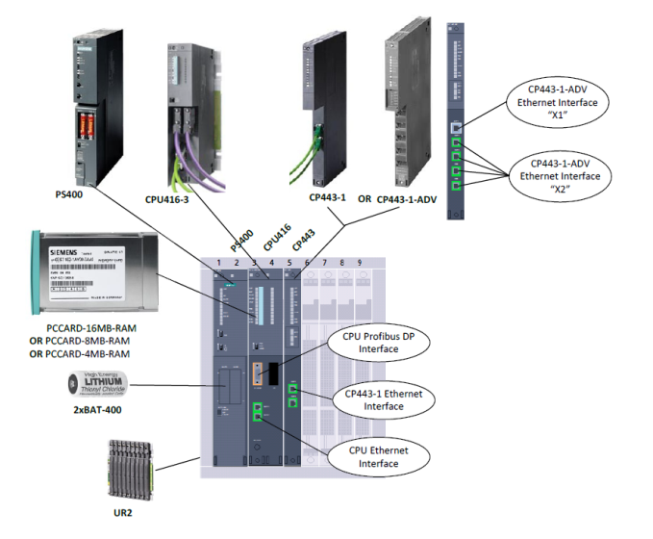
ITER’s Slow Controller: S7
Hardware catalogue defines S7 for Slow Controller
CODAC Core System uses the PSI S7PLC support
SDD creates configuration for PLC code and EPICS DB
Connecting 1000s of PLCs

Slide 3
ITER Extensions to S7PLC Driver
Redundant PLCs: driver talks to two PLCs
Timestamps from PLC
CODAC Frame: timestamp, redundancy status, magic numbers, application version
PSI code was heavily patched

Slide 4
Requirement: New Protocols
Native S7 Protocol (using nodave or snap7)
Allows writing or reading single variables
Full access to PLC data
Does not require changing PLC side code
Relatively slow
ISO-on-TCP
…?

Slide 5
Requirement: Events
Capture all changes in PLC retaining order (with PLC cycle resolution)
Packed single bits (BOOLEAN) and a timestamp
Both PLC and IOC buffer updates
PLC sends on change

Slide 6
ASYN Allows Modular Design
Raw TCP data block protocol: port driver
S7 protocol: port driver
Redundancy support: port driver
ISO-on-TCP: interpose layer
CODAC frame: interpose layer
Above: generic ASYN device support
Beneath: drvAsynIPPortDriver

Slide 7
Status
Original PSI driver functionality is working
Next: Redundancy, S7 protocol
Then: Events, ISO-on-TCP
Will be made available as pure EPICS module (no CODAC dependency) in Q1/2015

Slide 8
ASYN Driver for Files
Initial use case: Read numeric data (Linux daemon stats) from file into EPICS
Idea: Create port driver that reads from file, StreamDevice does the formatted read
More important use case: Run unit tests of ASYN drivers without any hardware, by replacing the device input stream with a file port

Slide 9
Status
Initial use case functionality (reading numbers from file) working
Will be made available as pure ASYN driver (no CODAC dependency) in Q1/2015

Slide 10
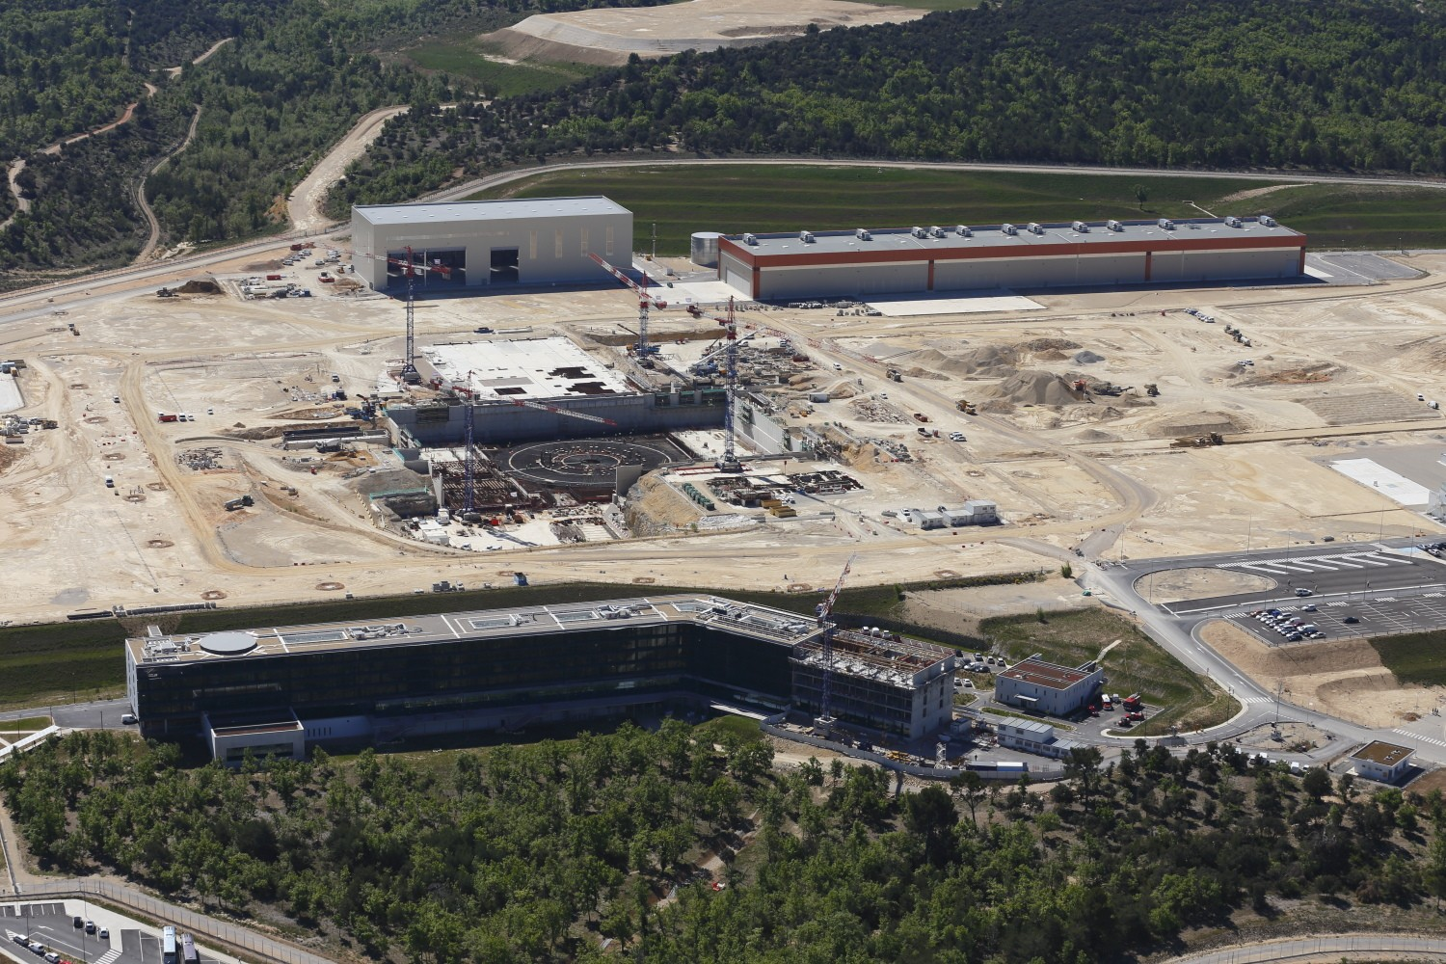
Thank you

